Slide 1

Block Memory on FPGA
www.anmaya.in

Slide 2
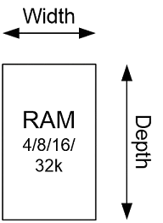
What is Block RAM (BRAM)
Block RAM (BRAM) = Embedded memory inside an FPGA
Also called Embedded Block RAM (EBR)
Discrete resource, only a limited number per FPGA
Amount of BRAM depends on:
FPGA family
FPGA size & cost
Used to store large amounts of on-chip data
www.anmaya.in

Slide 3
BRAM Characteristics & Usage
BRAM has fixed block sizes
Common sizes: 4 / 8 / 16 / 32 kb
Configurable width & depth
Clocked memory (synchronous operation)
Can be initialized at programming
Very useful for many FPGA applications:
Buffers
Lookup tables
FIFOs
www.anmaya.in

Slide 4
BRAM Types
Single-Port RAM
Dual-Port RAM
FIFO (built on BRAM)
www.anmaya.in

Slide 5
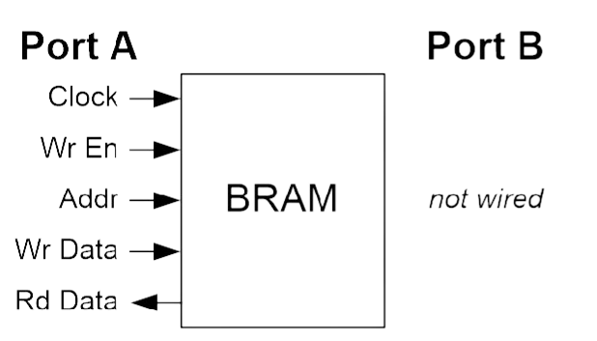
BRAM Types
1. Single-Port BRAM
What is Single-Port BRAM?
One memory port (Port A)
Can either read OR write in a clock cycle
Simplest BRAM configuration
Uses least FPGA resources
www.anmaya.in

Slide 6
BRAM Types
Single-Port BRAM – Operation
Fully clock-based
Read occurs on positive clock edge
Wr En = 0 → Read operation
Wr En = 1 → Write operation
Only one address accessed per cycle
Cannot read and write at the same time
www.anmaya.in

Slide 7
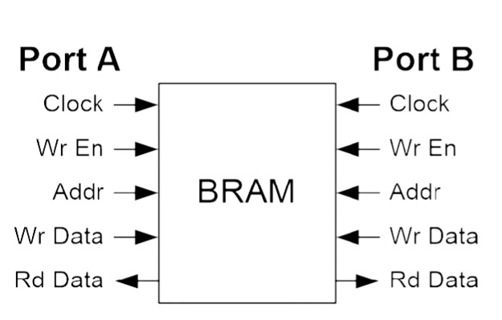
BRAM Types
2. Dual-Port BRAM (DPRAM)
What is Dual-Port BRAM?
Two independent ports: Port A & Port B
Each port can:
Read
Write
Ports operate simultaneously
Much more flexible than single-port BRAM
www.anmaya.in

Slide 8
BRAM Types
Dual-Port BRAM – Operation
Both ports are clocked
Port A and Port B can access:
Different addresses
Same clock cycle
Example:
Port A reads Address 0
Port B writes Address 200
Both in the same cycle
www.anmaya.in

Slide 9
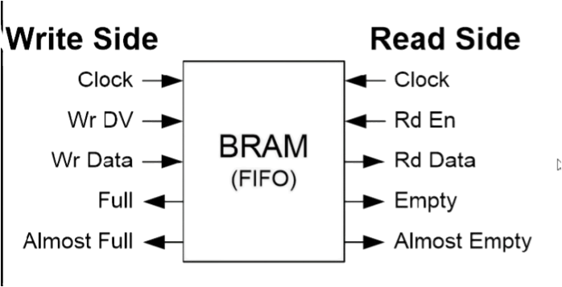
BRAM Types
3. FIFO using BRAM
What is a FIFO?
FIFO = First In First Out
Data read in the same order it is written
Built internally using Dual-Port BRAM
Extremely common in FPGA designs
www.anmaya.in

Slide 11
BRAM Types
FIFO BRAM – Why It’s Needed
Buffer data between two interfaces
Handle speed mismatch
Temporary data storage
Safe data transfer between blocks
www.anmaya.in

